Slide 1
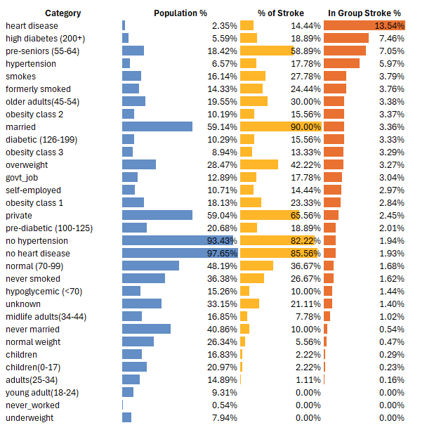
Reducing
Stroke Risk
Before the
Age of 65
By: John Paul Medina
June 24, 2025

Slide 2
Did you know that nearly 90% of stroke patients under the age of 65 are married?
Correlation ≠ Causation
Stroke
Age
Top 5 Leading Cause of Death
Strongest Predictor of Stroke

Slide 3



Goals:
Top
Risk
Risk
Age
Plan

Slide 4



Dataset
Age
Gender
Heart disease
Hypertension
BMI
Glucose level
Marriage history
Work type
Residence type
Smoking

Slide 5

Top Medically Modfiable Risk Factors
Heart Disease
Hypertension
Diabetes
Smoking

Slide 6

Heart Disease
6x
2.35%
of population
14.44%
of ALL stroke cases
13.54%
Stroke Rate
Increase in
Ages 35-44

Slide 7


Hypertension
11x
5.97%
stroke rate
May occur at
ANY AGE
Increase by age
18-24

Slide 8

Diabetes
4.78%
stroke rate
Affects 1 in 5 patients by age
45-54

Slide 9

Smoking
Nearly
25%
3.79% vs 3.76%
Smokers vs Former Smokers
History of smoking by
18-24

Slide 10
Recommendations:
18
Hypertension & Smoking
Screening, Education, and Preventive Care Plan
25
Diabetes
Screening and Preventive Care Plan
35
Heart Disease
Screening and Preventive Care Plan

